Slide 1
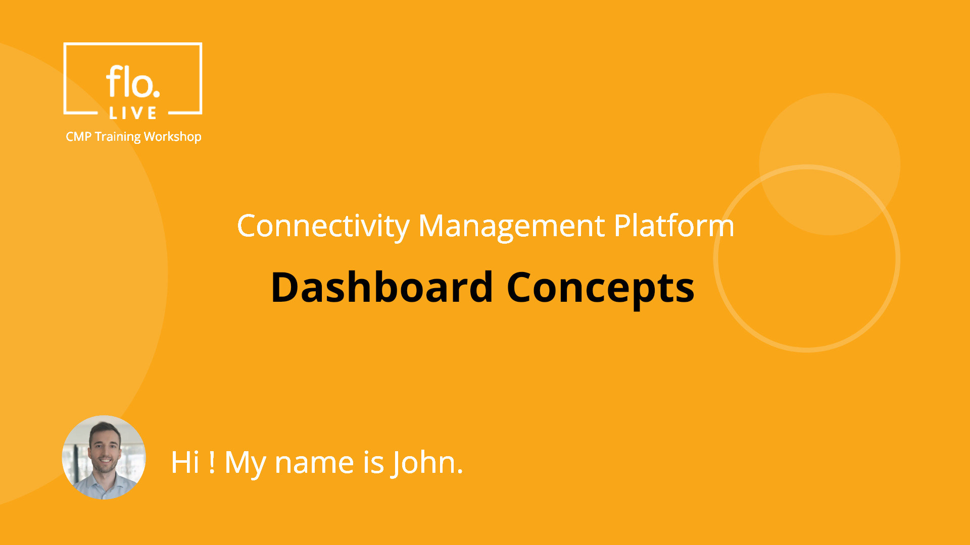
Notes:
Hi, My name is John and welcome to the CMP Training Workshop. In this tutorial we explain the basic concepts of the CMP Dashboard. Let's begin.

Slide 2
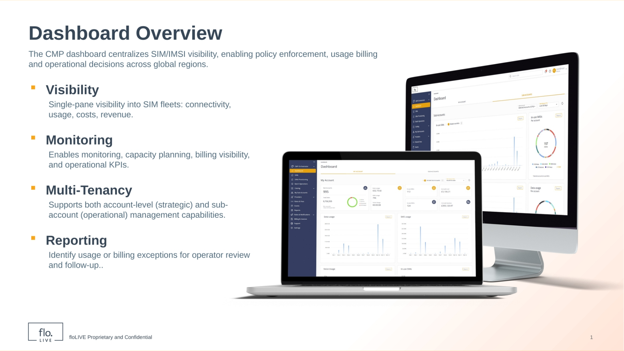
Notes:
The CMP dashboard centralizes SIM and IMSI visibility to support operational and billing decisions for all your accounts across any geographical region. The first main benefit of the CMP Dashboard is visibility. Visibility enables you to view connectivity status, usage volumes, costs, and revenue for your SIMs all from a single screen. A second important feature is the ability to monitor performance, plan capacity, review billing details, and track operational KPIs. The CMP dashboard also features Multi‑Tenancy. This means customers can implement SIM operations and policies at the parent account‑level and sub‑account level. Finally, the Reporting feature enables customers to identify usage or billing exceptions to ensure effective control over your SIMs.

Slide 3
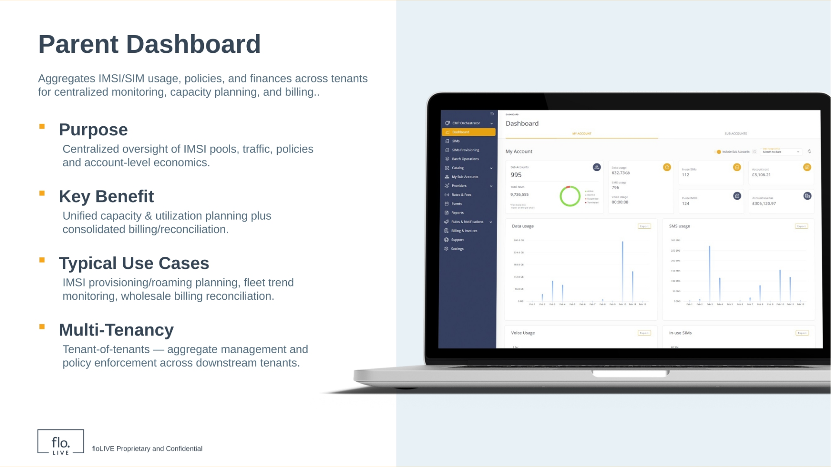
Notes:
Lets discuss the features of the My Account screen. This is the "Parent Account" screen and it is displayed by default when you access the Dashboard. The "Parent Account" provides a high-level consolidated view of all your SIMs and IMSIs, . This includes the status of SIMs, usage data metrics, key operational KPIs and financial data across all sub-accounts. Now, lets take an in-depth look at the dashboard metrics.

Slide 4
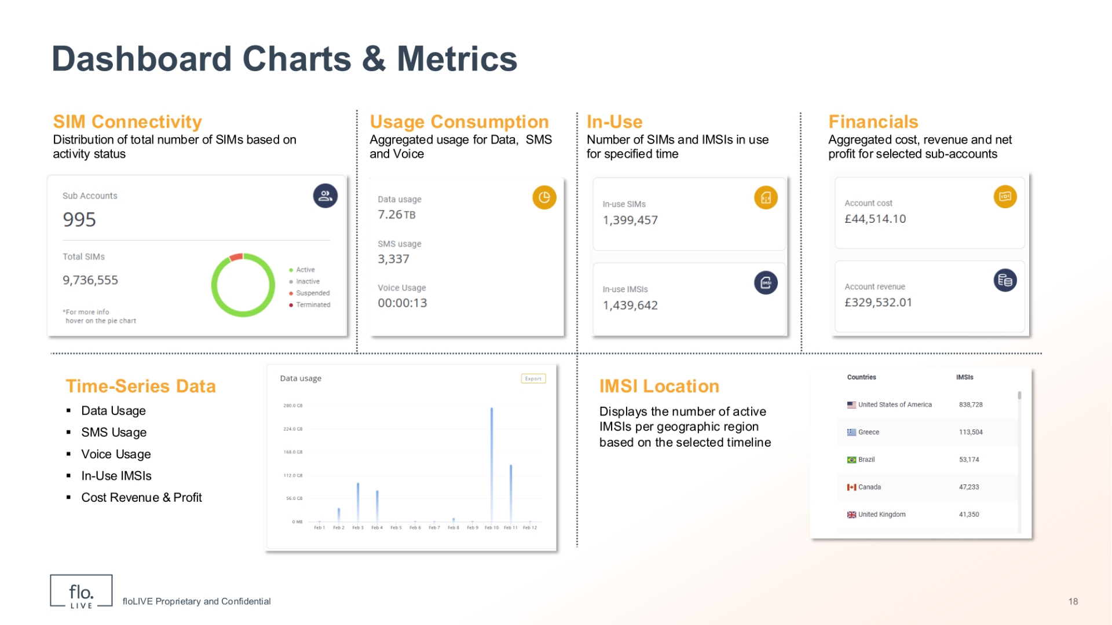
Notes:
The dashboard displays a wide range of data metrics. The SIM Connectivity widget shows the total number of Sub-accounts and SIMs according to current status. The SIM status can be active, inactive, suspended, or terminated. Next, the Usage Consumption widget displays aggregated information, for data, SMS, and voice traffic. Now take a look at the In‑use category. This widget reports the total number of active SIMs and IMSIs. The Financials widget shows the aggregated cost, revenue, and net profit for your sub‑accounts for a defined timeframe. When you scroll the page, you can view various charts that display: data, SMS, voice, and in‑use IMSI trends for a specified timeframe. Finally, the IMSI location chart maps active IMSIs based on geographic region.

Slide 5
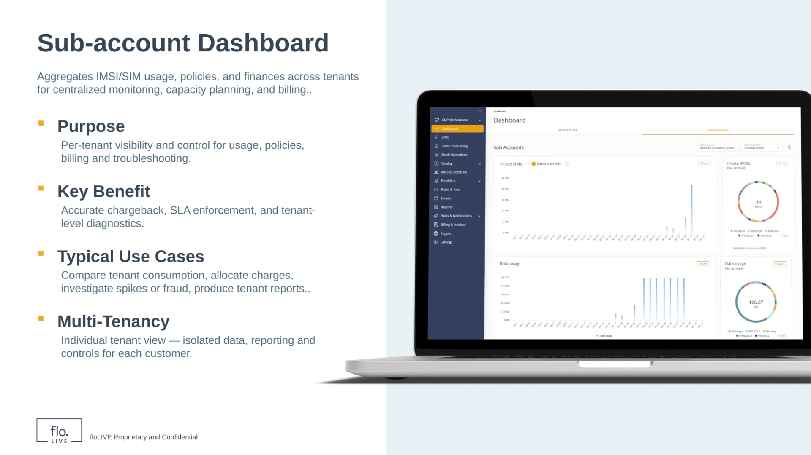
Notes:
Now lets discuss the Sub‑account dashboard. This screen shows the metrics and data for one or more sub‑accounts. For example, metrics include the total number of active SIMs and IMSIs, it also shows usage data and SMS trends, as well as a breakdown of revenue and costs. In contrast to the Parent account, which shows aggregated metrics across all sub‑accounts, this dashboard allows you to select one or more sub‑accounts.

Slide 6
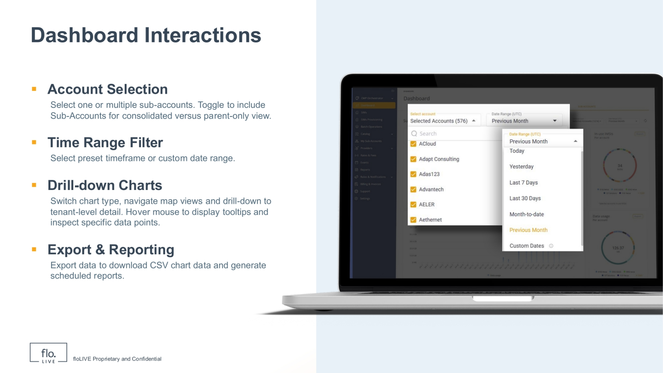
Notes:
The CMP Dashboard contains several interactions that enable you to focus your analysis. First, you can use the Account Selection drop-down to pick one or more sub-accounts. You can also toggle the Include Sub-accounts control to create a parent-only view or to include tenants. Second, you can use the Time Range Filter to apply preset ranges or set a custom date window for all charts. You can also hover over the screen elements to display informative tooltips on specific points. Finally, when you need offline analysis, you can export any or all chart data to a CSV file based on your selection settings.

Slide 7
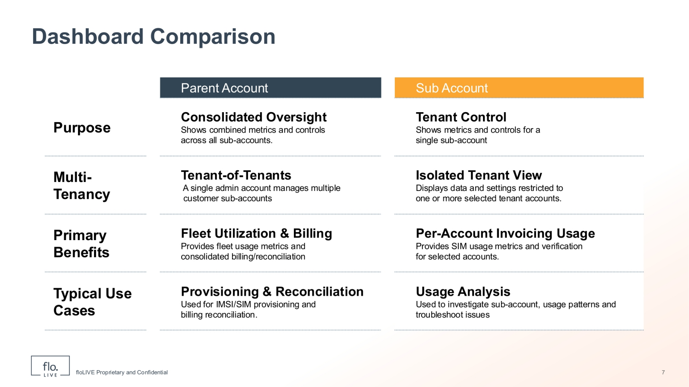
Notes:
To summarize this session, lets highlight the differences between the Parent Account and Sub‑Account Dashboards. The Parent Account Dashboard provides consolidated oversight across all sub‑accounts, showing fleet‑level metrics and controls for capacity planning and billing reconciliation. It operates as a tenant‑of‑tenants view where a single admin manages multiple downstream accounts, The Parent Account Dashboard is also used for provisioning and wholesale billing reconciliation. In contrast, The Sub‑Account Dashboard provides an isolated view for a single tenant, showing per‑account SIM usage and status metrics. It supports per‑account usage verification and troubleshooting, enabling you to investigate trends, allocate costs, and validate invoicing for selected tenants. We recommend you use the Parent Account view for aggregate, cross‑tenant planning and reconciliation, and use the Sub‑Account view when you need detailed SIM usage, billing details, or to troubleshoot a specific customer.

Slide 8

Notes:
Thank you for watching this video tutorial. For more information about the CMP system, make sure you visit our Knowledge-base that is accessible directly from the CMP Portal.

